Slide 1
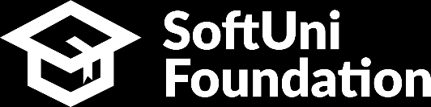


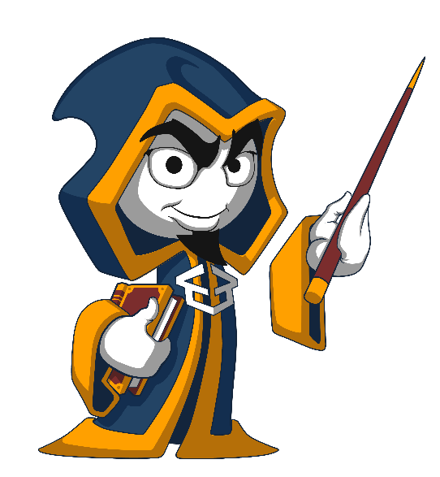
ASP.NET Core Cookbook
Application Security, Defending from Attacks
C# MVC Frameworks
SoftUni Team
Technical Trainers
Software University
http://softuni.bg

Slide 2
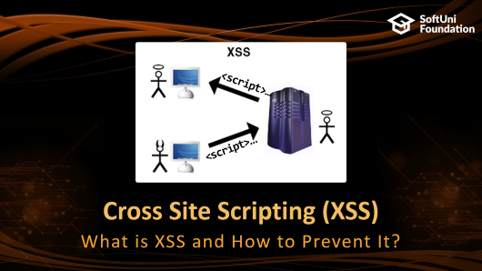
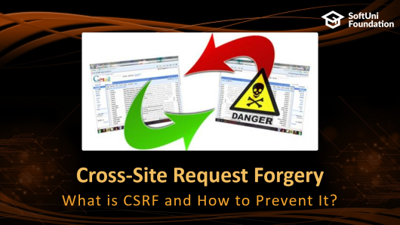


Table of Contents

Slide 3
Questions
sli.do #csharp-web

Slide 4

Application Security
Golden Rules and Guidelines

Slide 5
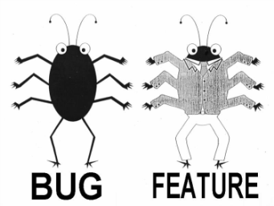
Web Application Security
Web Application Security is a necessary feature in every product
On the contrary, the absence of a developed security is to be treated as a bug.
A web application should be secured well
Security vulnerabilities are also considered software bugs.
If an application allows a foreign party to access inside data, most of the clients would consider it a software bug.
Notes:
Advanced Software Testing Vol. 1

Slide 6



Web Application Security
Software failures usually happen spontaneously
Without intentional mischief
Failures can be result of malicious attacks
For the Challenge / Prestige
Curiosity-driven
Aiming to use resources
Vandalizing
Stealing
Notes:
Software Security Testing, Gary McGraw
+
Software Testing, Ron Patton

Slide 7


Web Application Security Golden Rules
Maximum Simplicity
More complicated – greater chance for mistakes
Secure the Weakest Link
Hackers attack where the weakest link is
Limit the Publicly Available Resources

Slide 8




Web Application Security Golden Rules (2)
Incorrect Until Proven Correct
Consider each user input as incorrect
The Principle of the "Weakest Privilege“
Security in Errors (Remain stable)
Provide Constant Defense (also use backups)

Slide 9

Open Redirect Attacks
Request Parameter Tampering

Slide 10
Open Redirect Attacks
Web Applications often use request routing.
Redirecting to URLs which are passed as parameters through requests.
These parameters are potentially prone to tampering.
A foreign party can change the URL forcing the application to redirect to a malicious URL.

Slide 11
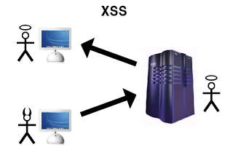
Cross Site Scripting (XSS)
<script>…
<script>…
What is XSS and How to Prevent It?

Slide 12
XSS Attack
Cross-site scripting (XSS) is a common security vulnerability in Web applications
The web application displays a JavaScript code that is executed at the client's browser
Crackers could take control over sessions, cookies, passwords, and other private data

Slide 13
How to Prevent XSS?
Validate the user input (built-in in ASP.NET Core)
Perform HTML escaping when displaying text data in a Web control

Slide 14

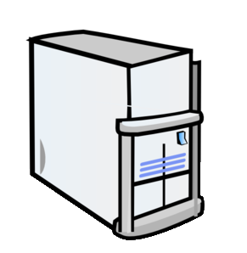
XSS Attack (2)
Cross-site scripting attack
Cookie theft
Account hijacking
Modify content
Modify user settings
Download malware
Submit CRSF attack
Password prompt
Execute the script on visiting the page
Submits script on an unsafe form

Slide 15
What is HTML Escaping?
HTML escaping is the act of replacing special characters with their HTML entities
Escaped characters are interpreted as character data instead of markup
Typical characters to escape: < > & ' , " etc.
Notes:
HTML escaping is the act of replacing special characters with their HTML entities
Escaped characters are interpreted as character data instead of markup
Typical characters to escape
<, > – start / end of HTML tag
& – start of character entity reference
', " – text in single / double quotes

Slide 16
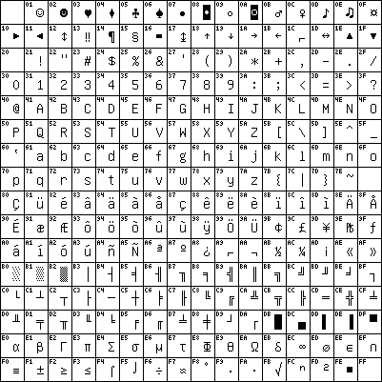
HTML Character Escaping
Each character could be presented as HTML entity escaping sequence
Numeric character references:
'λ' → &#955;, &#x03BB; or &#X03bb;
Named HTML entities:
λ → &lambda;
< → &lt;
> → &gt;
& → &amp;
" → &quot;
Notes:
Each character could be presented as HTML entity escaping sequence
Numeric character references:
'λ' is &#955;, &#x03BB; or &#X03bb;
Named HTML entities:
'λ' is &lambda;
'<' is &lt;
'>' is &gt;
'&' is &amp;
" (double quote) is &quot;

Slide 17
Preventing XSS in ASP.NET Core
The Razor template engine in ASP.NET Core escapes everything by default:
To render un-escaped HTML view use:
@{ ViewBag.SomeText = "<script>alert('hi')</script>"; }
@ViewBag.SomeText
&lt;script&gt;alert(&#39;hi&#39;)&lt;/script&gt;
@{ ViewBag.SomeText = "<script>alert('hi')</script>"; }
@Html.Raw(ViewBag.SomeText)
<script>alert('hi')</script>

Slide 18
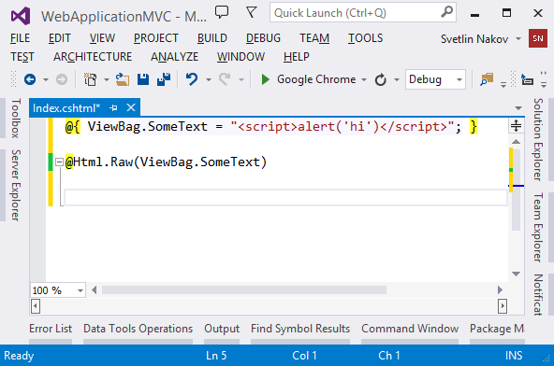
HTML Escaping in ASP.NET Core Apps
Live Demo
Notes:
*
12/5/201707/16/96
(c) 2005 National Academy for Software Development - http://academy.devbg.org. All rights reserved. Unauthorized copying or re-distribution is strictly prohibited.*
18##

Slide 19

Cross-Site Request Forgery
What is CSRF and How to Prevent It?

Slide 20
What is CSRF?
Cross-Site Request Forgery (CSRF / XSRF) is a web security attack over the HTTP protocol
Allows executing unauthorized commands on behalf of some authenticated user
The user has valid permissions to execute the requested command
The attacker uses these permissions to send a forged HTTP request without the user knowing

Slide 21
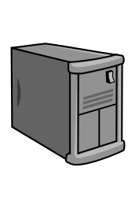
CSRF
Cross-site request forgery attack
Evil.com
<form action=“mysite.com/ChangePassword”>
MySite.com
Authentication cookie
Login
Submit data on behalf of User
User

Slide 22
Prevent CSRF in ASP.NET Core
To prevent CSRF attacks in MVC apps use anti-forgery tokens
Put the anti-CSRF token in the HTML forms:
Verify the anti-CSRF token in each controller action that should be protected:
@using (@Html.BeginForm("Action", "Controller"))
{
…
@Html.AntiForgeryToken()
}
[ValidateAntiForgeryToken]
public ActionResult Action(…)
{ … }

Slide 23
Prevent CSRF in ASP.NET Core
It is recommended to use [AutoValidateAntiForgeryToken].
Applied Globally
Only for non-API scenarios
Has a Generic version
services.AddMvc(options => options.Filters .Add(new AutoValidateAntiforgeryTokenAttribute()));
services.AddMvc(options => options.Filters .Add<AutoValidateAntiforgeryTokenAttribute>();

Slide 24
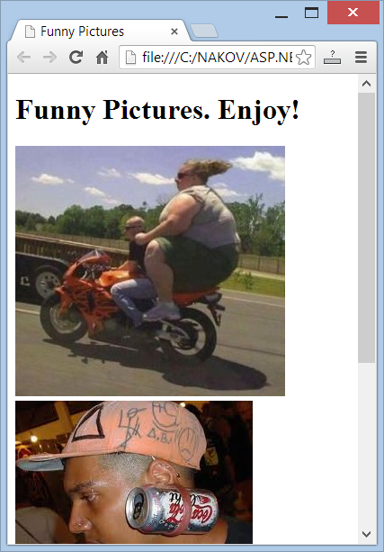
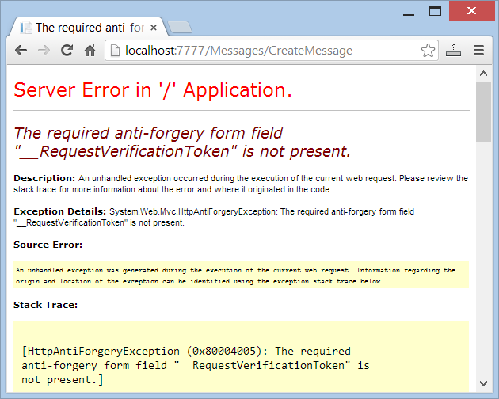
Anti-CSRF in ASP.NET Core Apps
Live Demo

Slide 25
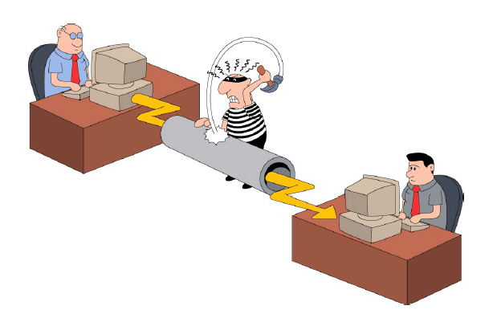
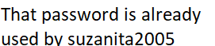
Other Threats
Man in the Middle (MiTM)
Session Hijacking (easy if the session is part of the URL)
Always use SSL when sending sensitive data!
Insufficient Access Control
Error messages can reveal information

Slide 26

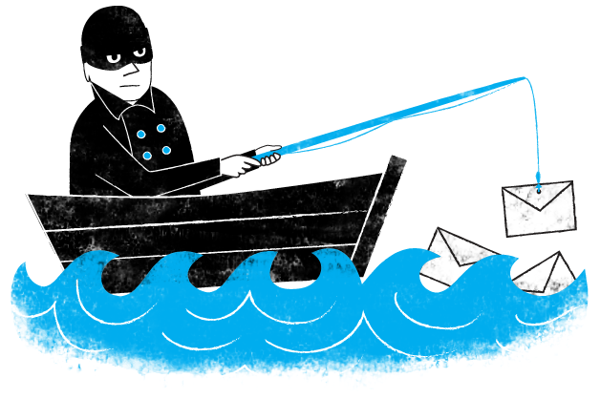
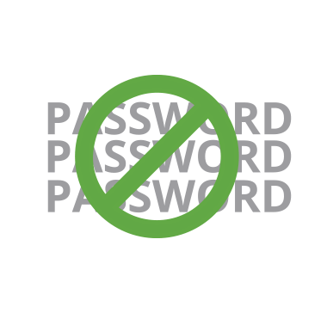
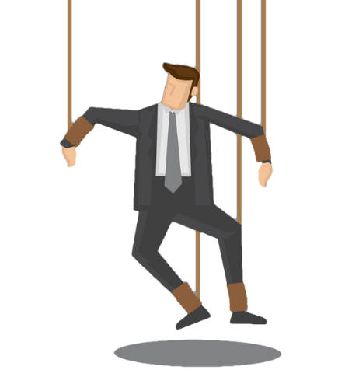
Other Threats (2)
Denial of Service (DoS and DDoS)
Brute force (use CAPTCHA!)
Phishing
Security flaws in other software you are using
Social Engineering

Slide 27


Summary
Web Security Concepts
Open Redirect Attacks
Cross Site Scripting (XSS)
Cross Site Request Forgery
Other Attacks

Slide 28







C# MVC Frameworks – Cookbook
https://softuni.bg/courses/asp-net-mvc

Slide 29
License
This course (slides, examples, demos, videos, homework, etc.) is licensed under the "Creative Commons Attribution-NonCommercial-ShareAlike 4.0 International" license

Slide 30
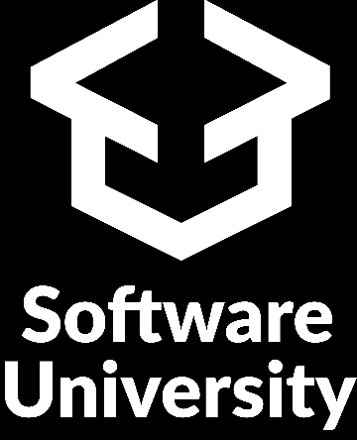




Trainings @ Software University (SoftUni)
Software University – High-Quality Education, Profession and Job for Software Developers
softuni.bg
Software University Foundation
http://softuni.foundation/
Software University @ Facebook
facebook.com/SoftwareUniversity
Software University Forums
forum.softuni.bg

